Slide 1
CMN130 Introduction to Journalism
Week 2
News values

Slide 2
Overview
Definitions of news
Standard news values
How to report news
The who, what, when, where, how, and why of news

Slide 3
Definitions of news
“the first rough draft of history” (Bradlee in Hough 1984: 60)
“anything that makes a reader say ‘gee, whiz!’” (MacEwen)
“anything you can find out today that you didn’t know before” (Catledge)
“anything that will make people talk” (Dana)
News = new

Slide 4
Standard news values
How do journalists make decisions about what is news?
Important strand of journalism studies
Long tradition (since 1960s)
Broad similarities, but also many differences

Slide 5
Gatekeeping theory
Journalists act as “gates”
Based on David M. White’s (1950) study of “Mr Gates”, regional US wire editor
Examined decisions for acceptance and rejection of news stories
Originally focused on individuals’ decisions, later broadened to include routines, organisational, structural and societal/cultural levels

Slide 6
Galtung & Ruge (1965)
Seminal study on news values
Gatekeeping as “a process of successive selections, according to a number of news values or criteria which affect the perception of news events”
Newsworthiness as a set of 12 criteria
Frequency, threshold, unambiguity, meaningfulness, consonance, unexpectedness, continuity, composition, reference to elite persons and nations, personalisation, negativity.

Slide 7
Harcup & O’Neill (2001)
Follow-up to Galtung & Ruge
Studied British newspaper coverage
10 news values for the 21st century
Power elite, celebrity, entertainment, surprise, bad news, good news, magnitude, relevance, follow-up, newspaper agenda

Slide 8
Critical Review
Both Galtung & Ruge and Harcup & O’Neill based on analysing content
News values are employed by journalists
Is it possible to decide motivations and internal decision-making from content?
There is no set list that all journalists have and make decisions from

Slide 9
Another set of news values
Murray Masterton (1995)
Interviews with journalists in 67 countries
Set of news values adopted in News as it Happens and for CMN130
Three essential elements allow information to become news:
Interest
Timeliness
Clarity

Slide 10
Masterton’s six news values
Significance/impact
Proximity
Conflict
Human interest
Novelty
Prominence

Slide 11
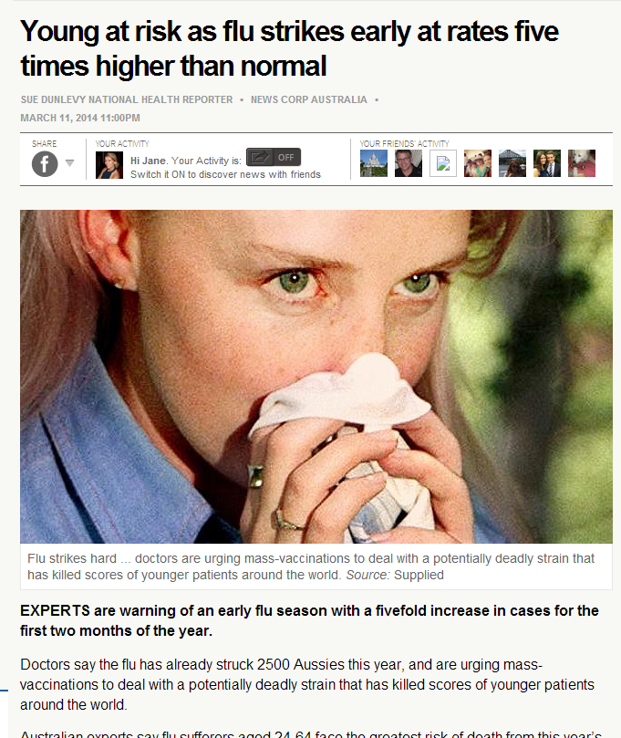
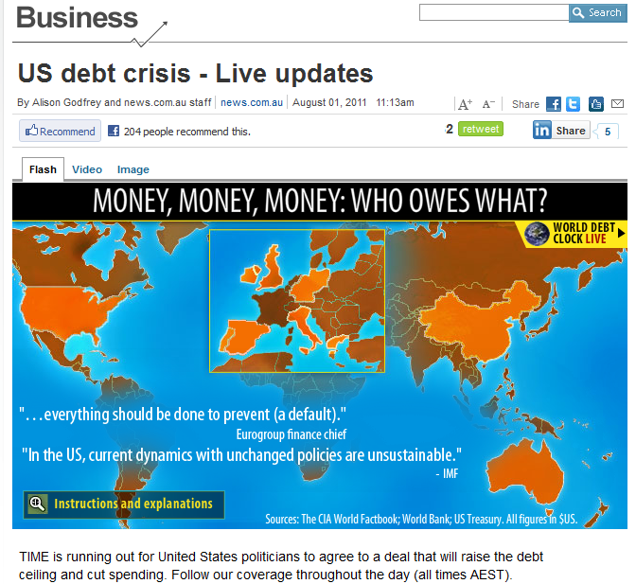
Significance/impact

Slide 12
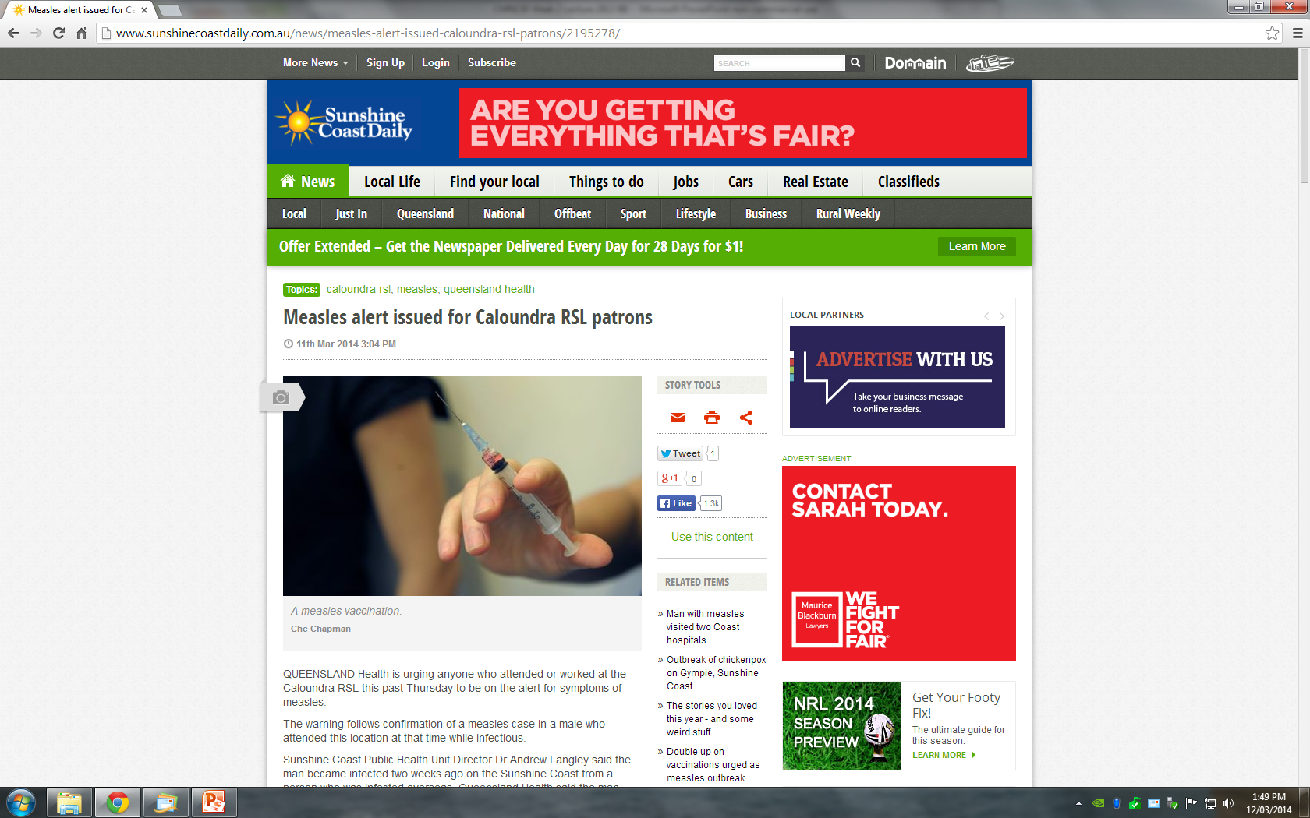
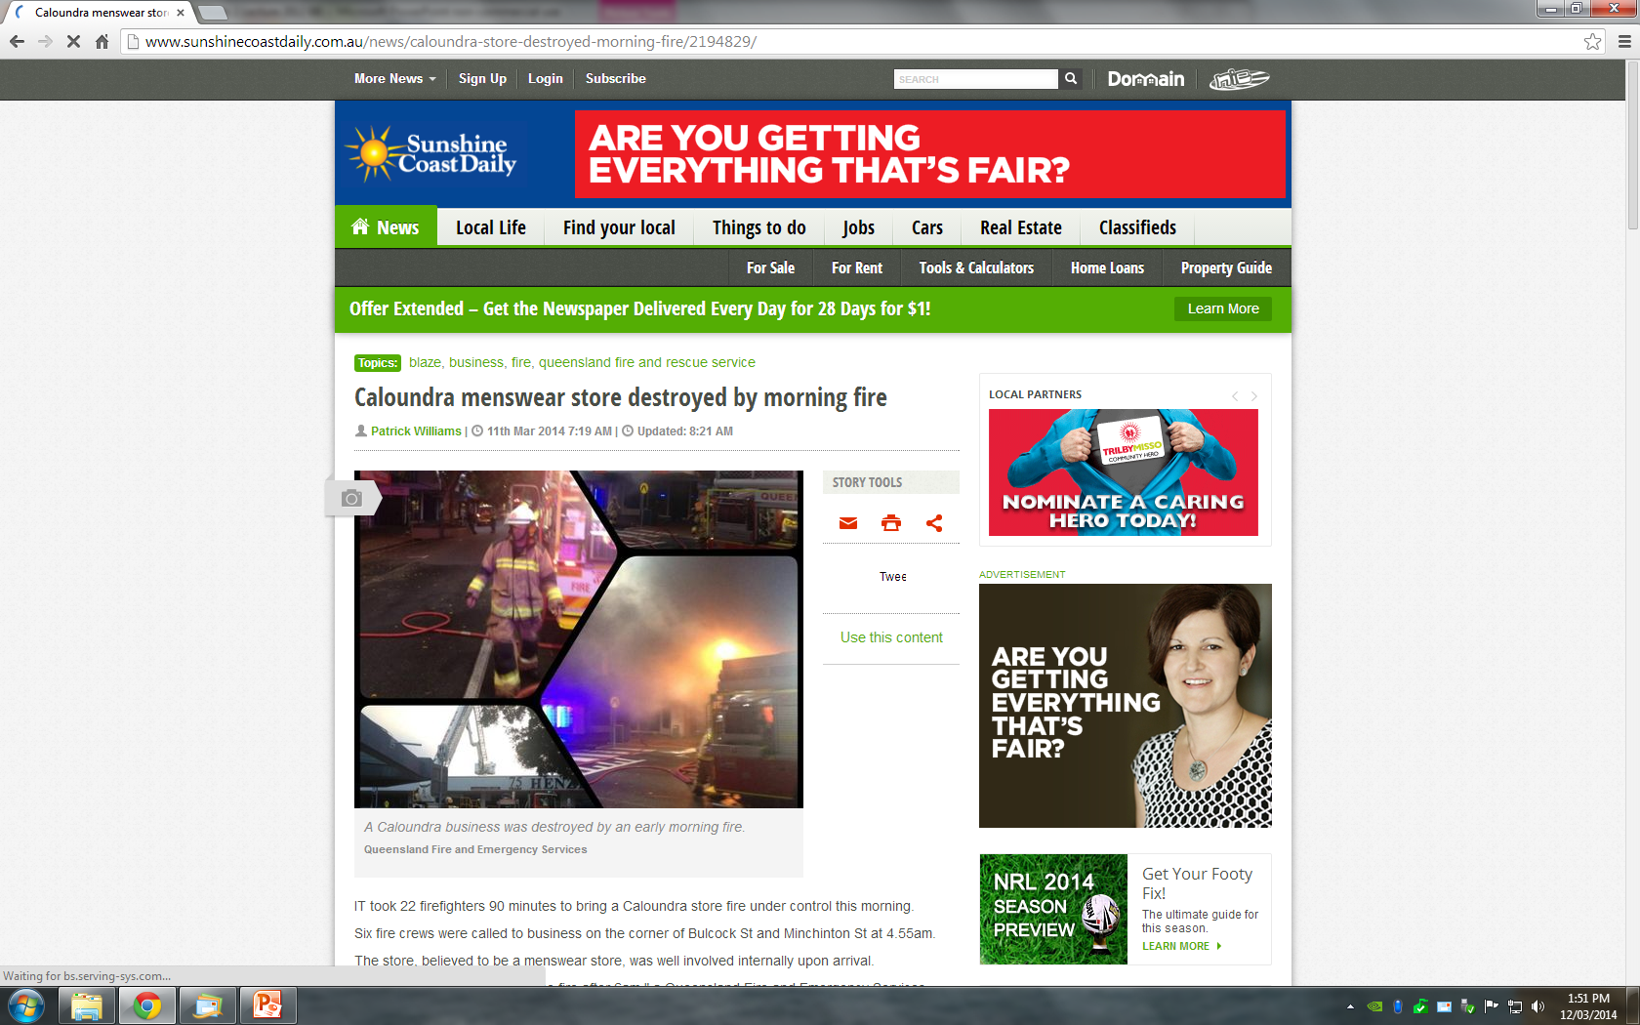
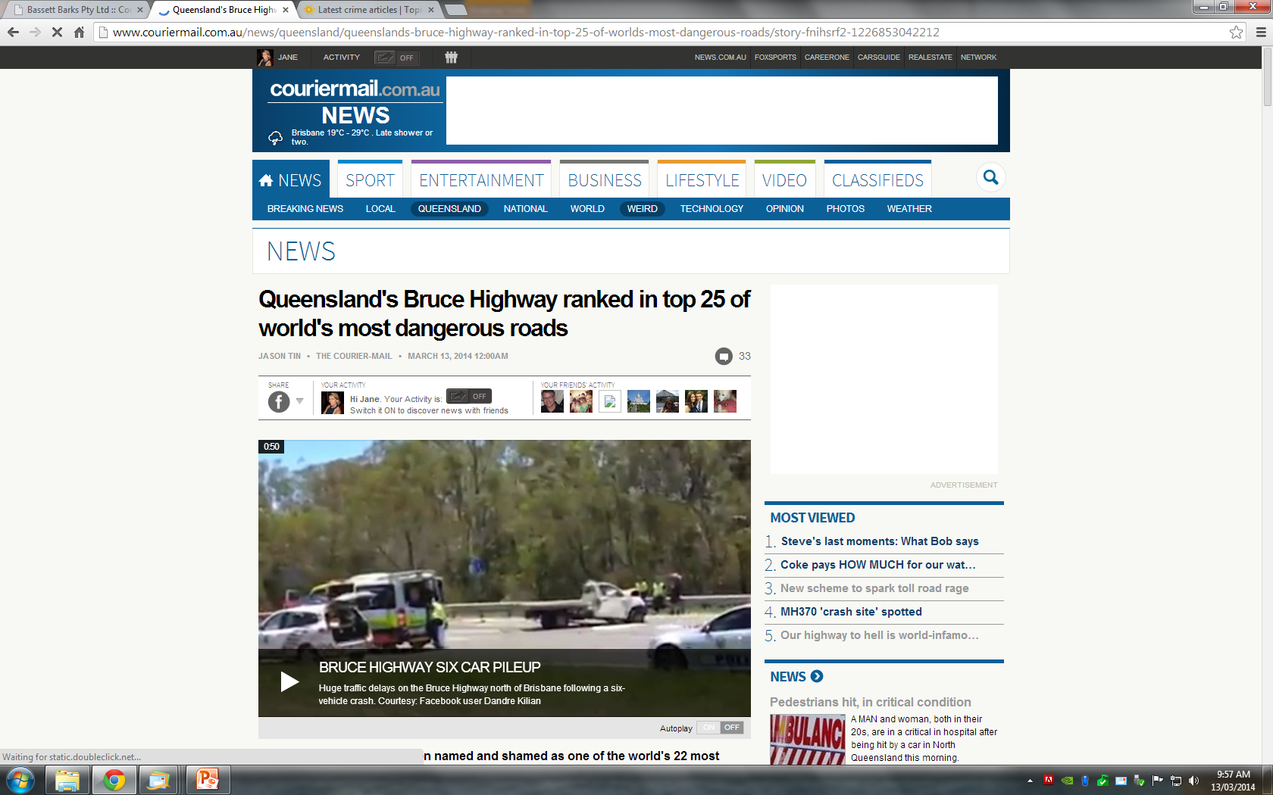
Proximity

Slide 13
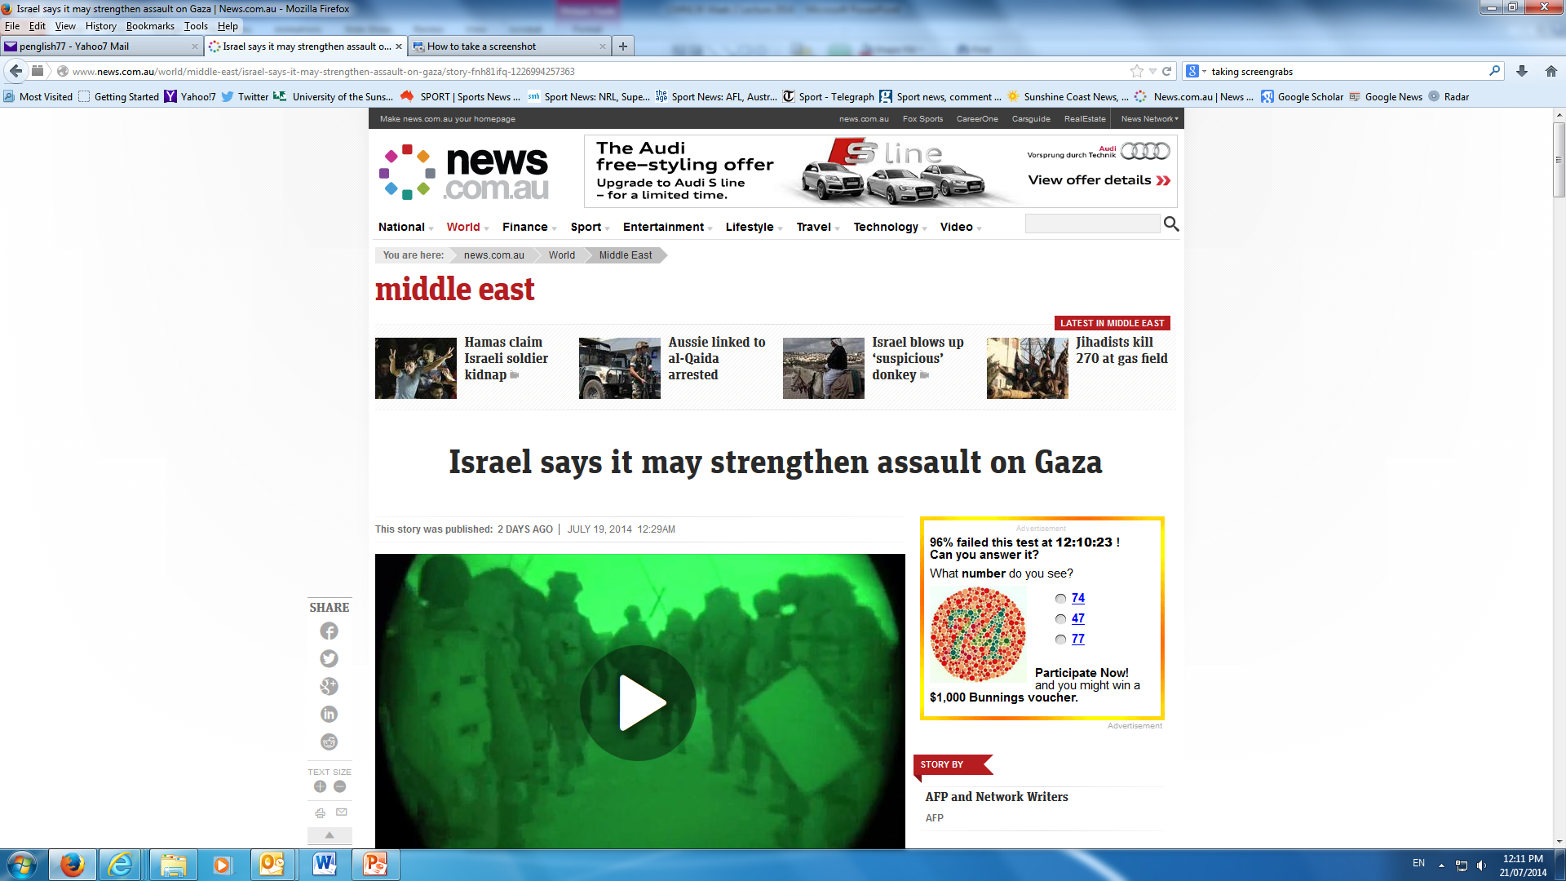
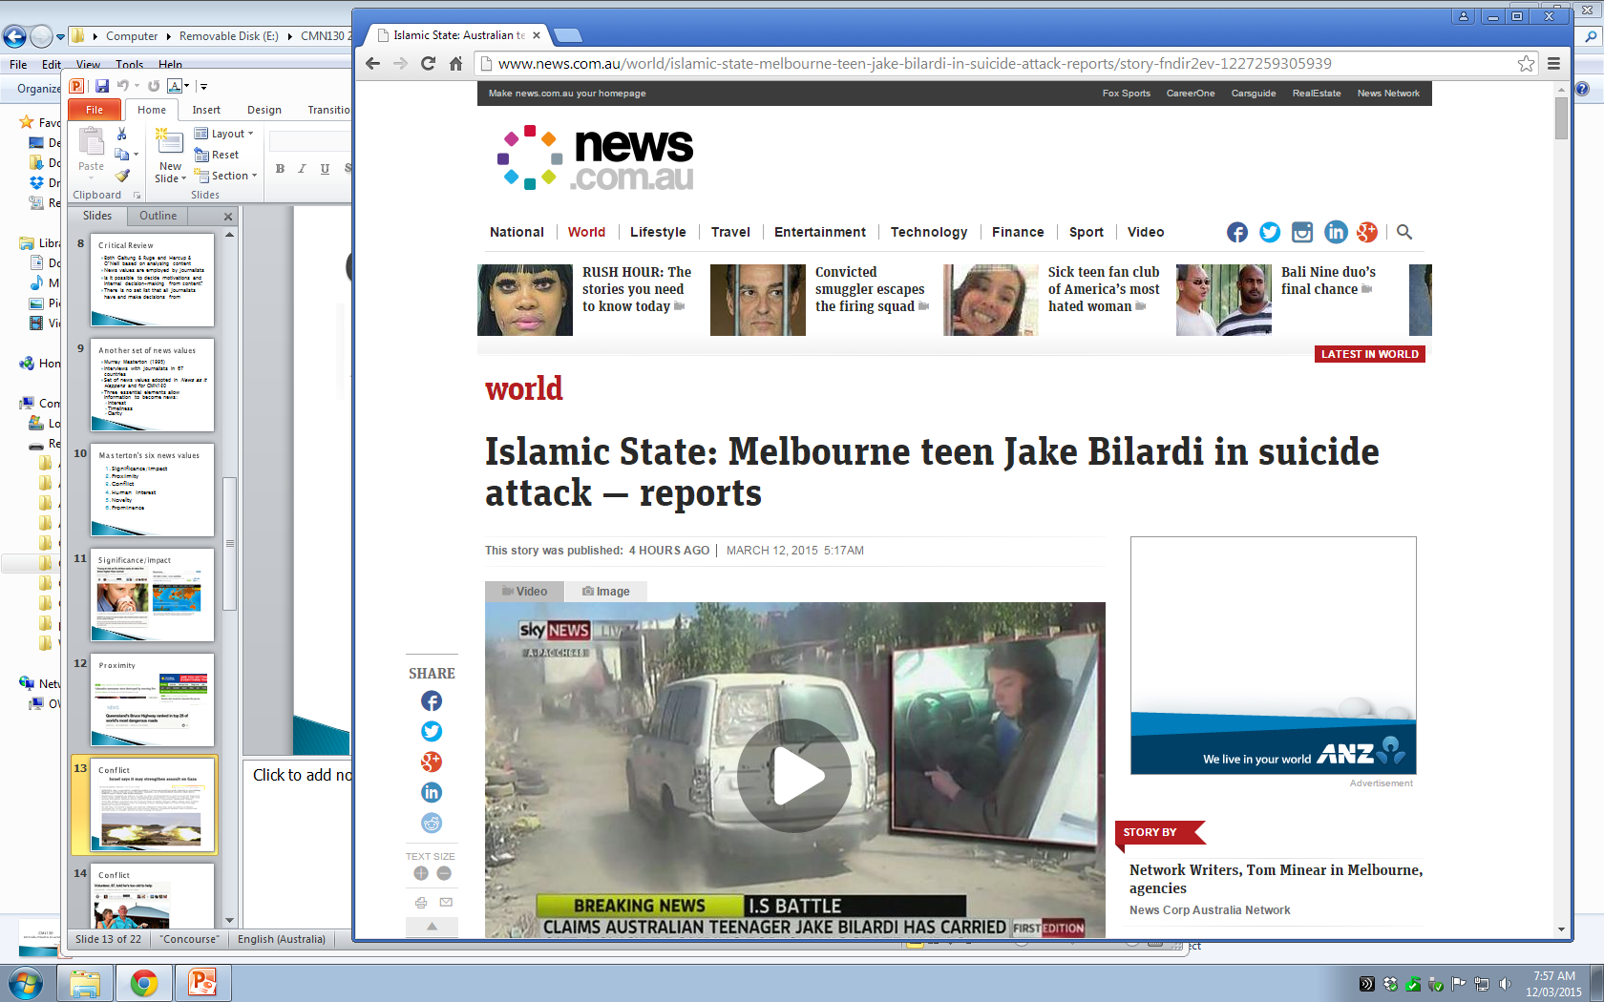
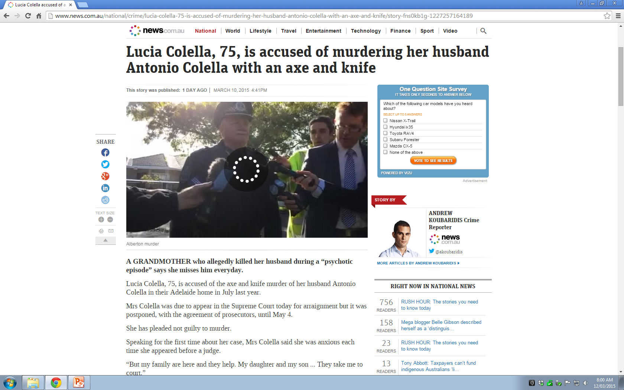
Conflict

Slide 14
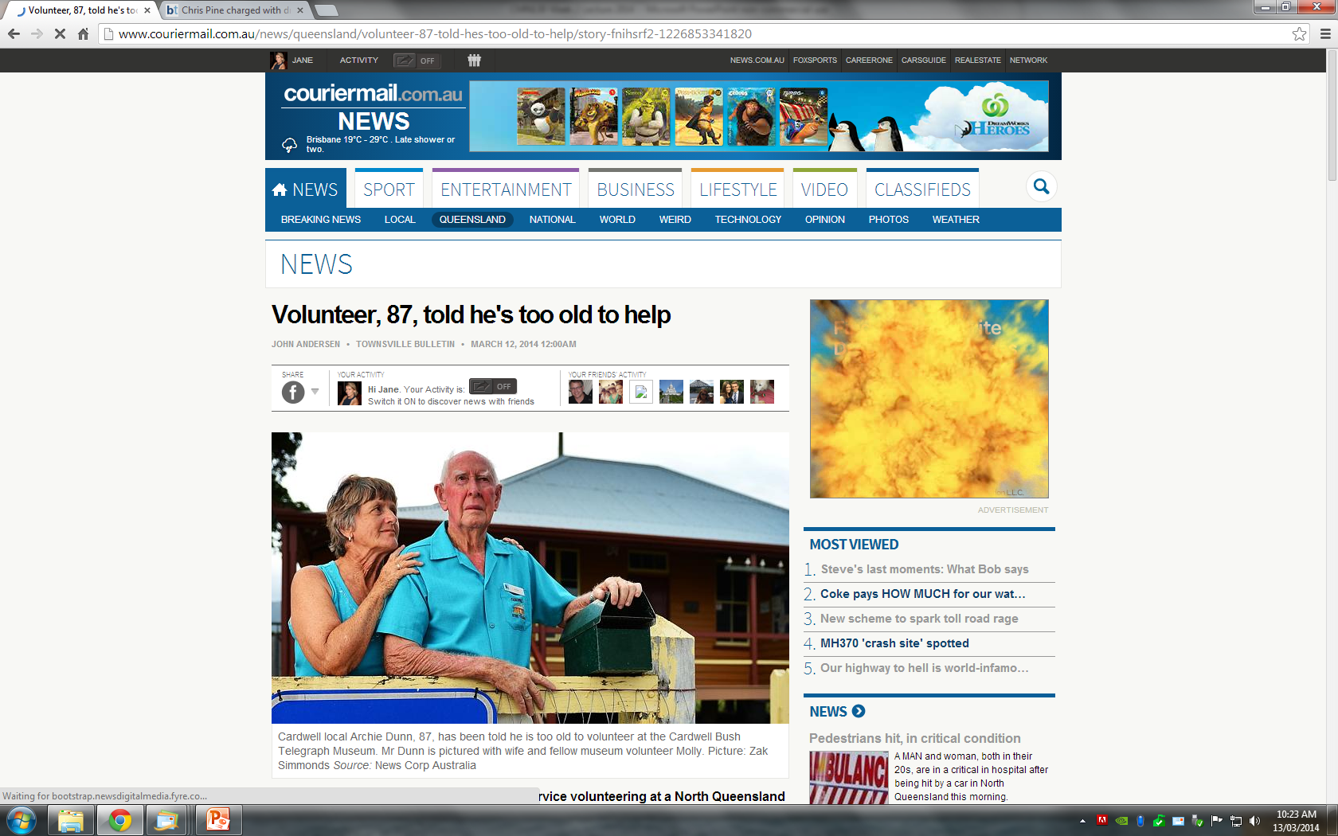
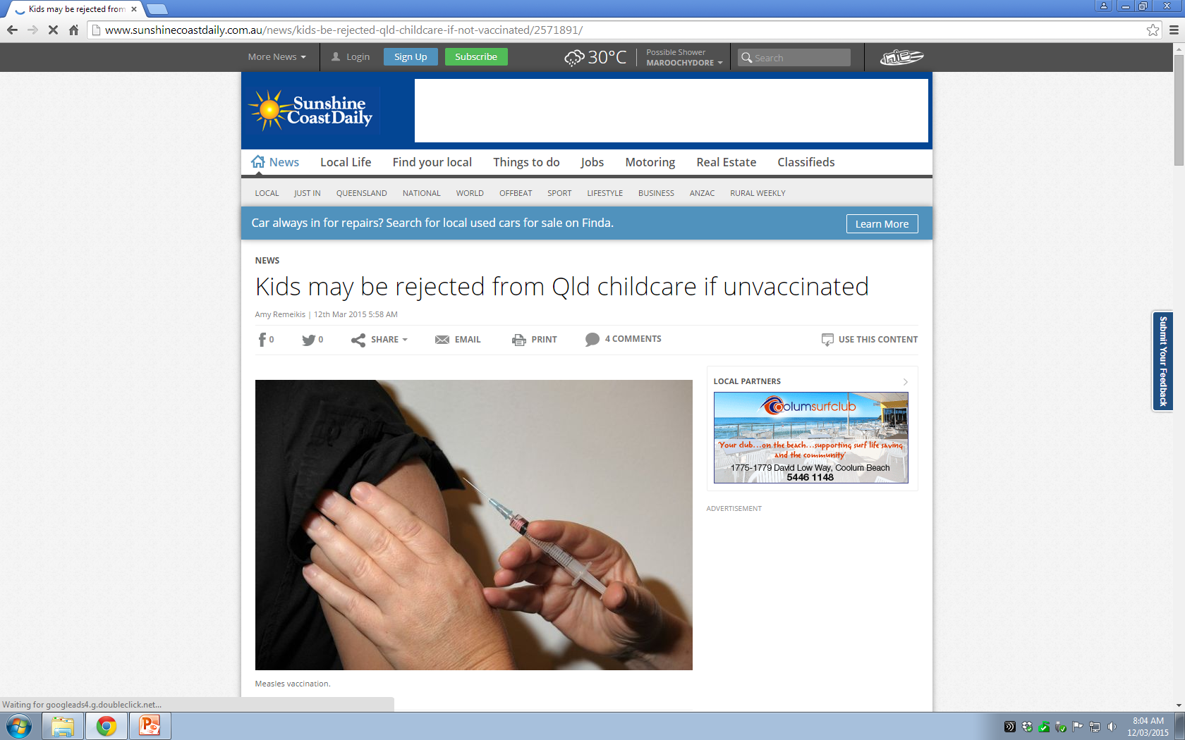
Conflict

Slide 15
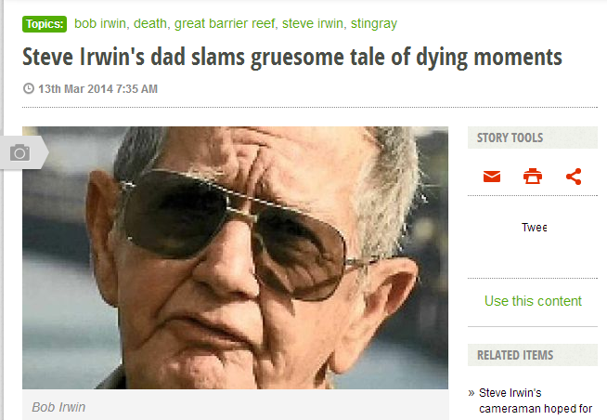
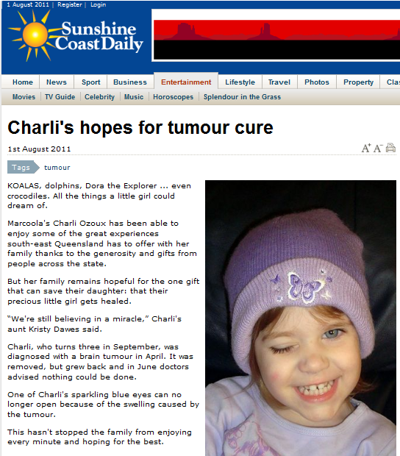
Human interest

Slide 16
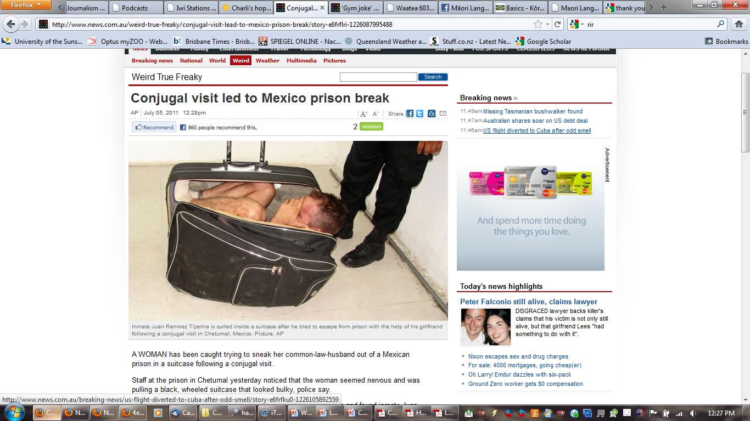
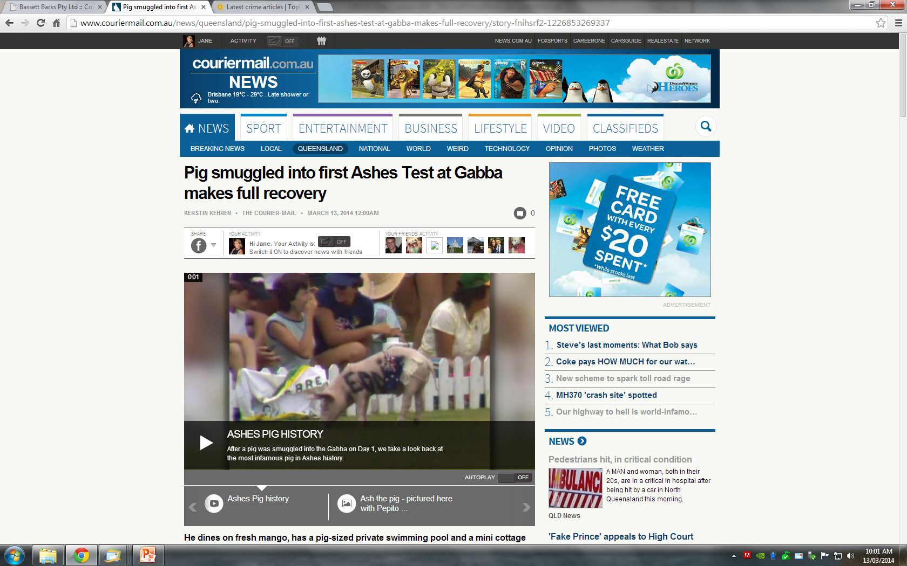
Novelty/the unusual

Slide 17
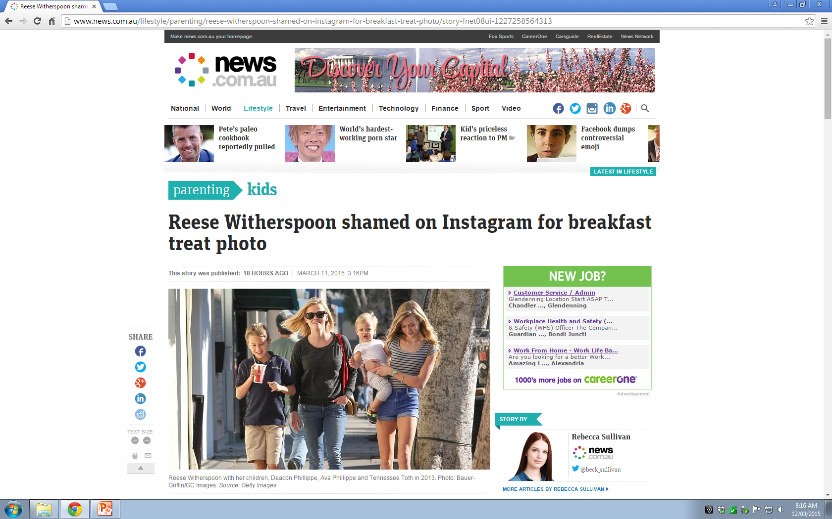
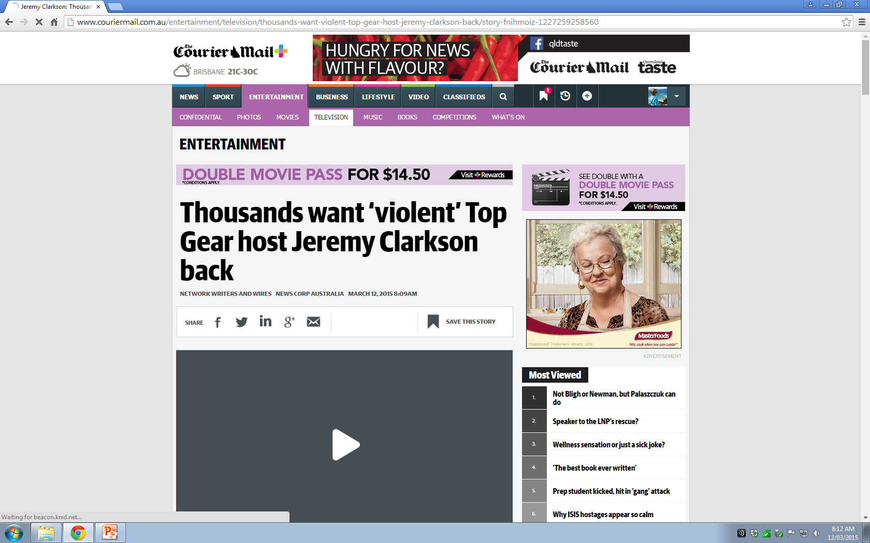
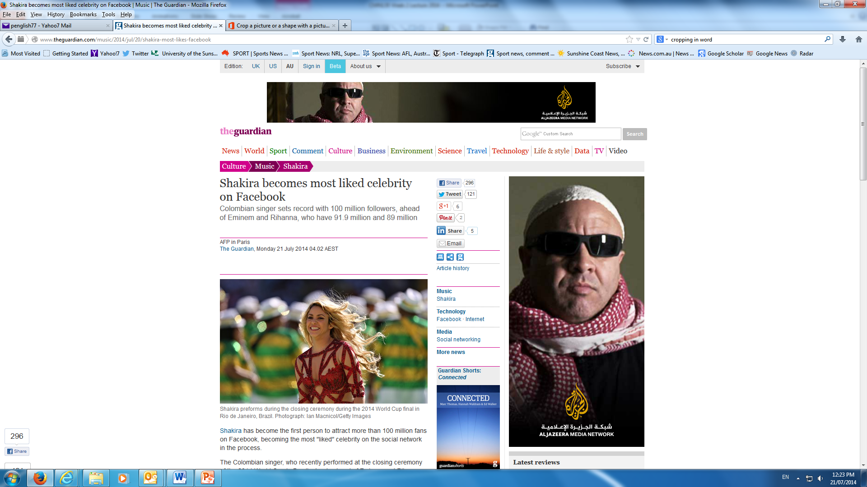
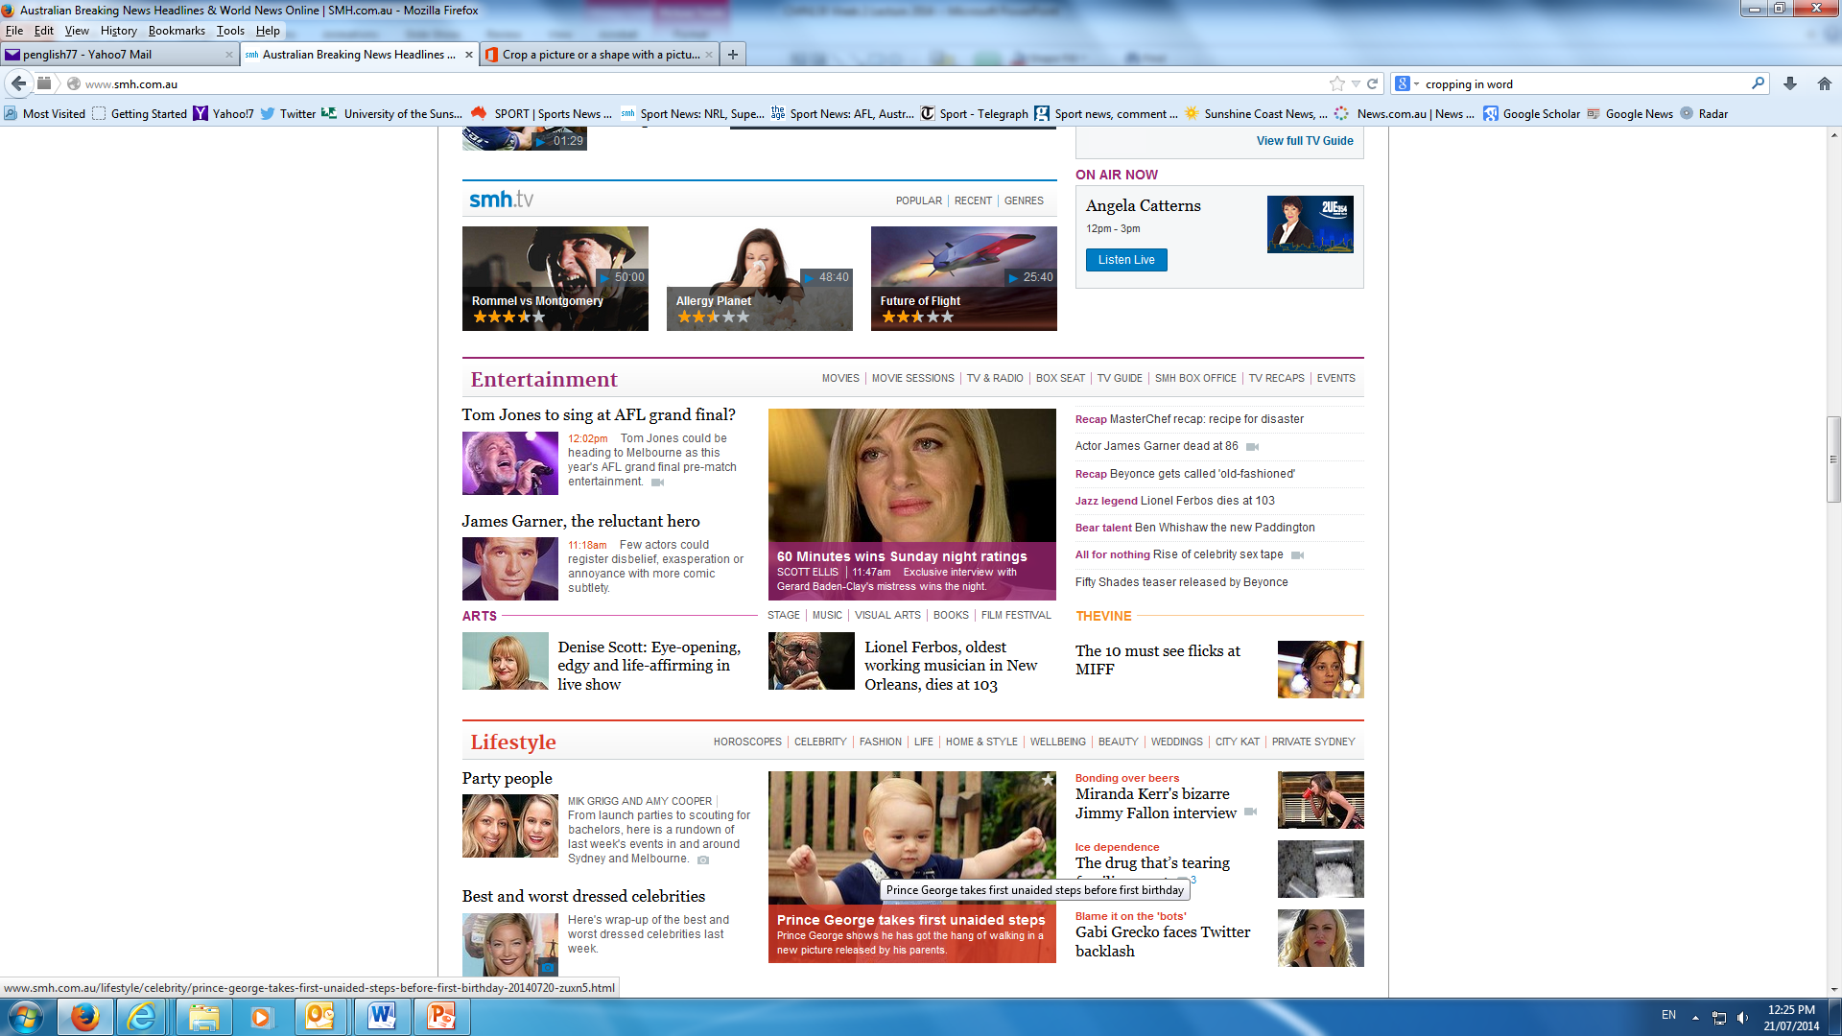
Prominence

Slide 18
How to report news
In 1902 British journalist, poet and author Rudyard Kipling explained “news” in the following terms when he wrote:
I keep six honest serving-men,
(They taught me all I knew);
Their names are What and Why and When
And How and Where and Who.
I send them over land and sea,
I send them east and west … (in Kipling 1986: 291)

Slide 19
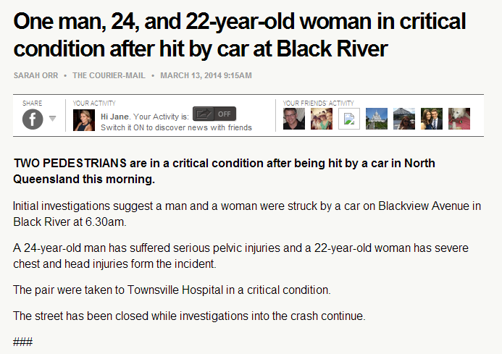
Who What Where When How Why

Slide 20
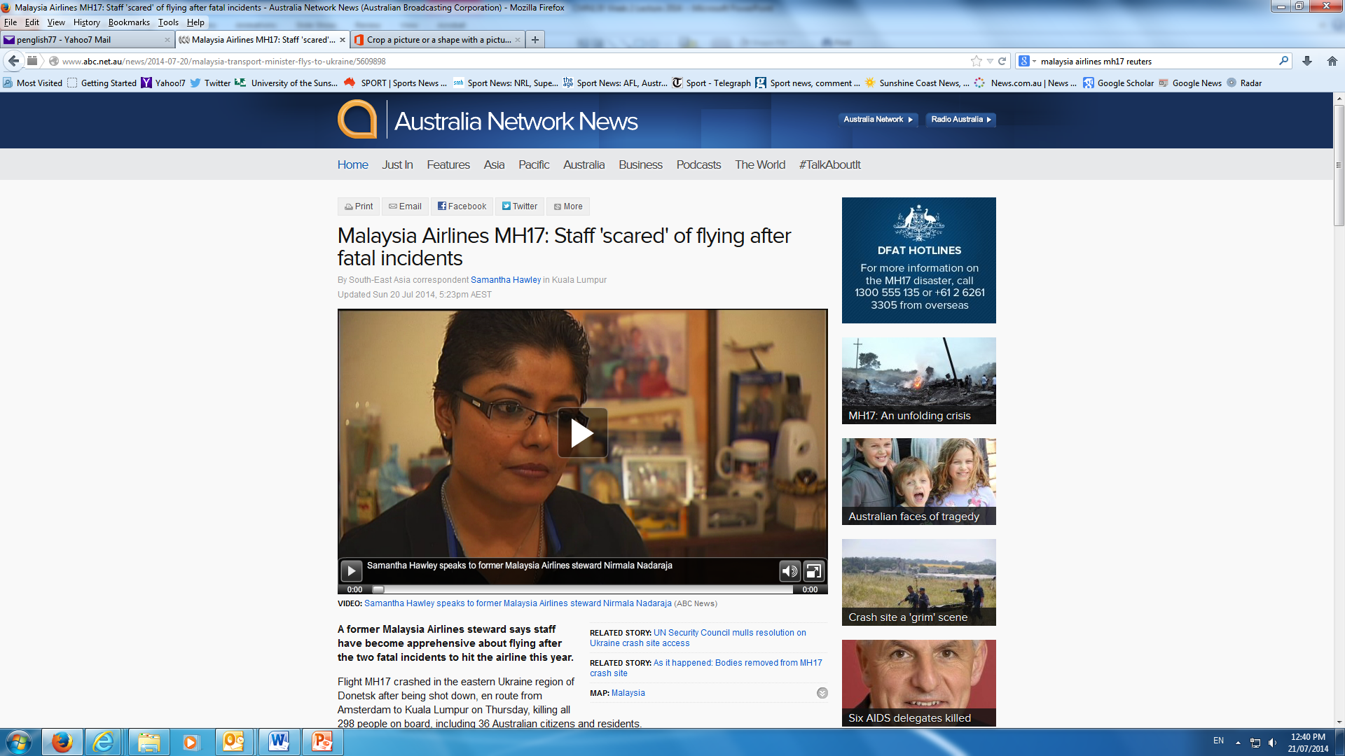
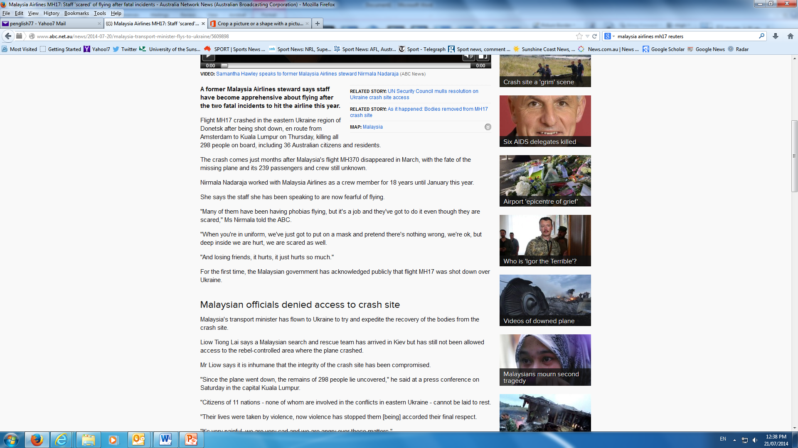
Who What Where When How Why

Slide 21
News can never be perfect
Important to understand that by its nature it is virtually impossible for news to be perfectly presented
As Tiffen says: “Covering the news is an infinite, impossible task. News is therefore an exercise in imperfection, the product of a series of compromises.” (Tiffen: 28)

Slide 22
Readings
Week 2: Chapter 3 – News Values
This will help with your assignment, which is on Blackboard

